Slide 1





mecatronics
Project
By J. Bousliman , M. Mouisse and O. Errouji
framed by Pr Y. Chaibi and Pr N. Lachgar

Slide 2
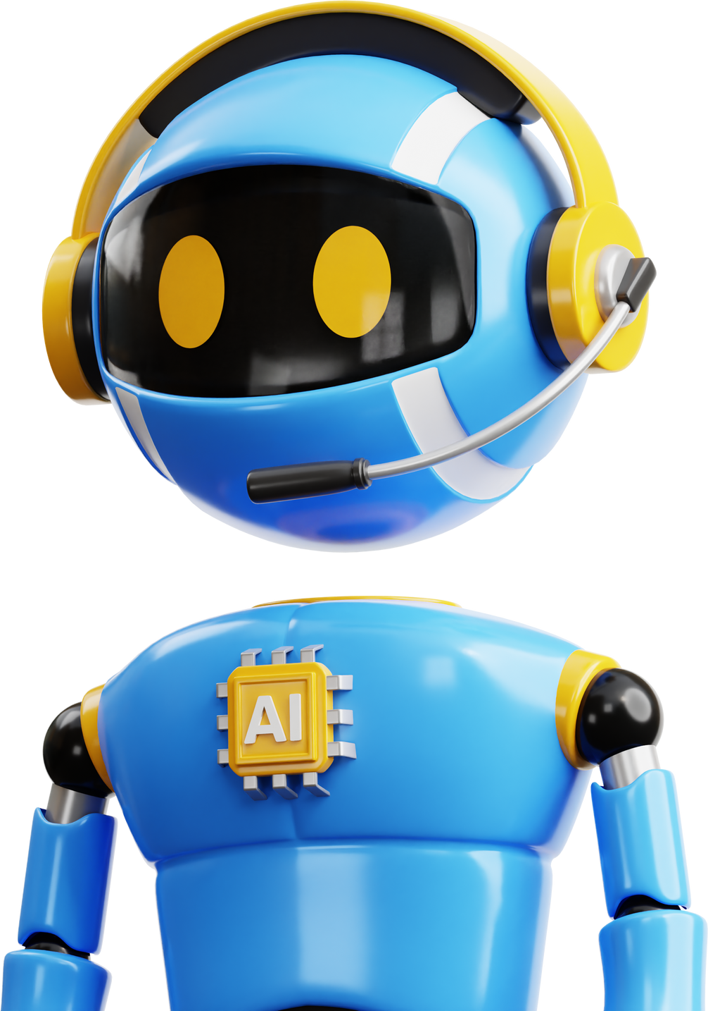

Table of contents
Introduction
Project idea
Components
Circuit
Teamwork
Difficulties
01
02
03
04
05
06

Slide 3
Introduction
About
Our Project
Project Highlight
In the ever-evolving landscape of technology, the pursuit of inventive human-computer interaction methods has birthed a fascinating project – CorDino.
This project aims to redefine the conventional keyboard interaction paradigm by seamlessly integrating a sound sensor, a gyroscope, a servo motor, LED indicators, a buzzer, and a mode-switching mechanism, all orchestrated by Arduino.
The ultimate goal?
To transform the mundane act of playing with the offline dinosaur game in Google Chrome into an engaging and accessible experience, breaking barriers between the digital world and the physical user.

Slide 4
Project Idea
Vocal Mode
Hand Mode
Imagine a world where playing the classic offline dinosaur game in Google Chrome becomes a dynamic and interactive experience. CorDino leverages Arduino technology to achieve this vision. At its core, the project incorporates a sound sensor strategically positioned to capture ambient audio signals. When activated, this sensor triggers a servo motor, simulating the space bar press required to make the dinosaur jump in the game. This sound detection mode not only adds a touch of accessibility but transforms the simple act of playing the game into an engaging and interactive venture.
But the innovation doesn't stop there. The project also introduces a gyro mode, facilitated by a gyroscope sensor. Users can now control the dinosaur's jumps by rotating their hand equipped with the gyroscope. This gesture-based interaction brings a new level of intuitiveness and physical engagement to the game. A strategically placed switch allows users to seamlessly toggle between these modes, offering a versatile and customizable experience tailored to individual preferences.

Slide 5
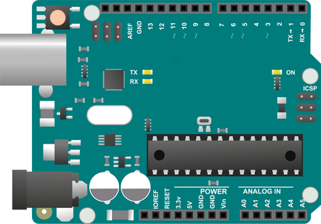

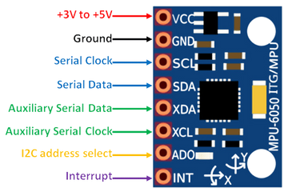
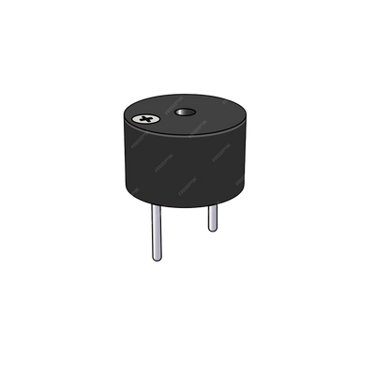
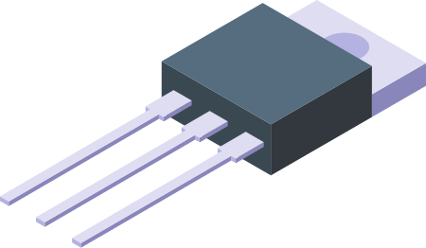
Components
01
02
03
04
Arduino UNO
Servo motor
MPU-6050 GY-521
Buzzer
The Arduino Uno is an open-source microcontroller board based on the Microchip ATmega328P microcontroller (MCU) and developed by Arduino.cc
It is a motor capable of maintaining opposition to a static force and whose position is continuously checked and corrected according to the measurement.
Description:
click the link
Description:
click the link
Transistor
Description:
click the link

Slide 6

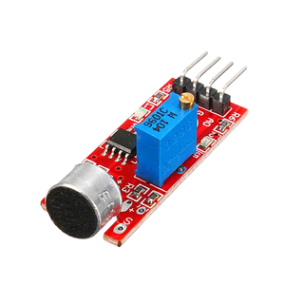
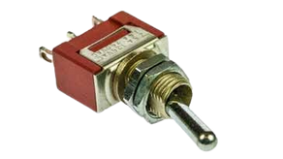
Components
05
06
Sound Sensor
Switch
Buzzer
Description:
click the link
Transistor

Slide 7
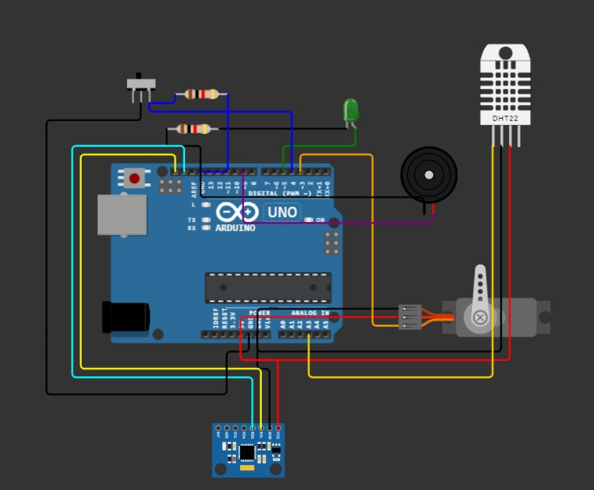
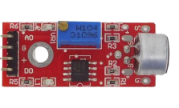
Circuit
Buzzer
Transistor

Slide 8

Teamwork
Embarking on the development of CorDino was a collaborative journey that showcased the strength of effective teamwork. Our three-member team was meticulously structured, with each member assigned a distinct role that played a crucial part in bringing the project to fruition. This division of responsibilities not only optimized our individual skills but also fostered a collaborative environment where the synergy of our efforts flourished.

Slide 9

Difficulties
Challenges encountered during the course of this project can be categorized into both physical and logical realms.
In terms of physical challenges, factors such as pricey component prices, constraints in time management, spatial limitations leading to disorganization in team gatherings and meetings, imminent exams, and incidents involving the use of welding equipment and candles have posed significant hurdles. On the logical front, issues arising from malfunctioning components, challenges in code implementation, and disruptions in the Arduino Integrated Development Environment (IDE) have added complexity to the project development process.

Slide 10


Thank You!

